Slide 1


AI-ASSISTED PROCUREMENT INTELLIGENCE
QUORIX
AI Decision Intelligence for Transparent & Defensible Procurement
Created by Riya Chauhan
riyachauhan2608@gmail.com
01 / 11

Slide 2
THE PROCUREMENT CRISIS
Traditional procurement systems are broken. Here's the data.
30-45
100+
ZERO
HIGH
MINUTES
VENDORS
AUDIT TRAIL
RISK
Per bidder evaluation time spent manually reviewing documents
Vendor submissions evaluated manually per procurement cycle
Defensible decision records for governance compliance
Governance risk from inconsistent and biased evaluations
Procurement officers manually evaluate vendors in spreadsheets, review hundreds of document pages, compare vendors inconsistently, and struggle to justify decisions to auditors.
Procurement Delays
Manual processes slow down every decision
Inconsistent Decisions
No standardized evaluation framework
Weak Transparency
Decisions lack explainable reasoning
02 / 11

Slide 3
THE BIG INSIGHT
What if procurement decisions were explainable?
✕ TRADITIONAL PROCUREMENT
✓ QUORIX INTELLIGENCE
Documents — Manual review of hundreds of pages
Upload — Tender documents (PDF/DOCX/TXT)
Extract — AI parses bidder information
Spreadsheets — Disorganized data entry & comparison
VS
Evaluate — Weighted scoring & risk analysis
Subjective Decisions — Bias-prone, hard to justify
Compare — Multi-bidder ranking & insights
Decide — Explainable, defensible outcomes
Slow · Inconsistent · Non-Auditable
Fast · Consistent · Fully Auditable
03 / 11

Slide 4
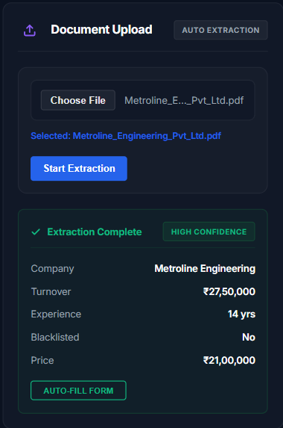
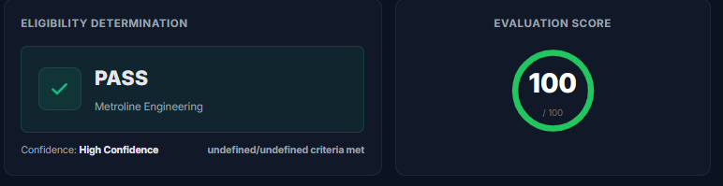
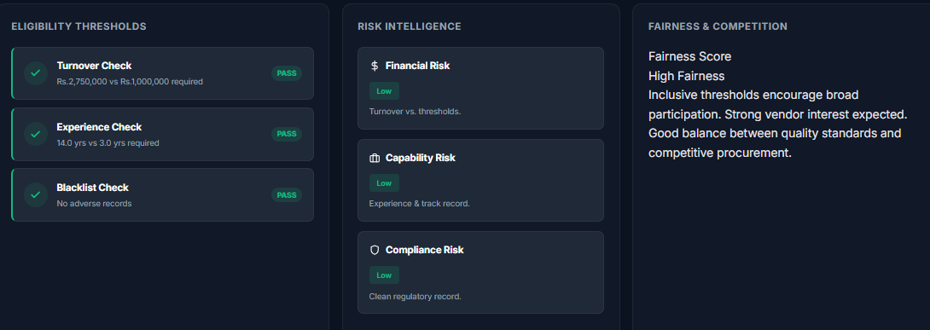
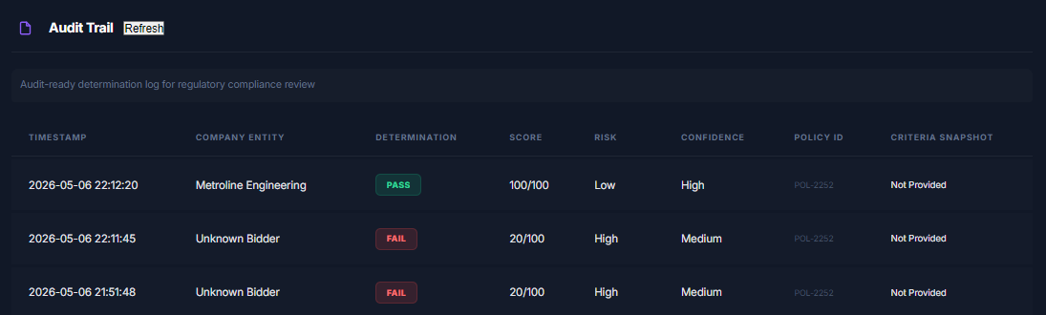
PRODUCT SHOWCASE
The AI-assisted procurement intelligence platform in action
Document Extraction
PDF · DOCX · TXT parsing
AI Evaluation Engine
Weighted scoring & risk analysis
Audit Trail
Governance-ready decision logs
Policy Simulation
Dynamic criteria & what-if analysis
Bidder Comparison
Side-by-side vendor ranking
CONFIDENCE SCORING
RISK INTELLIGENCE
EXPLAINABLE AI
AUDIT-READY
04 / 11

Slide 5
AI DECISION ENGINE
Explainable, weighted, and confidence-driven procurement scoring
WEIGHTED SCORING
RISK INTELLIGENCE
Financial Risk
LOW
Turnover Compliance (40%)
35.0
87.5
Capability Risk
LOW
Experience Threshold (30%)
27.5
SCORE
Compliance Risk
HIGH
Blacklist Compliance (20%)
20.0
POLICY ALIGNMENT
92% MATCH
Price Competitiveness (10%)
5.0
● HIGH CONFIDENCE
EXPLAINABLE REASONING
"Bidder meets minimum turnover threshold (₹50Cr vs required ₹25Cr). 15+ years of relevant experience exceeds policy requirement. No blacklist records found. Price quote is within competitive range. Recommended for shortlisting."
05 / 11

Slide 6
MULTI-BIDDER COMPARISON
Intelligent vendor ranking with recommendation engine
VENDOR | SCORE | TURNOVER | EXPERIENCE | RISK | STATUS | RANK
TechFlow Solutions | 92.4 | ₹85 Cr | 18 Years | LOW | QUALIFIED | #1
DataCore Systems | 87.5 | ₹62 Cr | 15 Years | MEDIUM | QUALIFIED | #2
CloudBridge Inc | 74.2 | ₹28 Cr | 8 Years | MEDIUM | MARGINAL | #3
Vertex Dynamics | 45.0 | ₹12 Cr | 4 Years | HIGH | REJECTED | #4
AI RECOMMENDATION
CONFIDENCE: 94%
"TechFlow Solutions ranks #1 with highest composite score (92.4), lowest risk profile, and full policy compliance. Recommended as primary bidder. DataCore Systems qualifies as viable alternative."
06 / 11

Slide 7
AUDIT TRAIL & GOVERNANCE
Every procurement decision becomes transparent and defensible.
EVALUATION LOG
Accountability
Every evaluation tied to a user, timestamp, and policy version. No anonymous decisions.
14:32:05 UTC
EXTRACTED
Document parsed: 4 bidder submissions extracted from tender_2024_Q3.pdf
14:32:18 UTC
EVALUATED
Traceability
Weighted scores calculated for all 4 bidders against policy criteria v2.1
Complete chain of custody from document upload to final recommendation. Fully auditable.
14:32:31 UTC
COMPARED
Multi-bidder comparison generated with risk matrix and ranking
Governance Ready
Supabase PostgreSQL persistence ensures records survive audits, reviews, and compliance checks.
14:32:45 UTC
RECOMMENDED
AI recommendation issued: TechFlow Solutions (#1) with 94% confidence
Supabase Backend
14:32:52 UTC
SAVED
Persistent storage for evaluations, audit history, and vendor records.
Evaluation snapshot stored to Supabase with full policy configuration
07 / 11

Slide 8
LIVE PLATFORM FLOW
End-to-end procurement intelligence pipeline
UPLOAD
EXTRACT
EVALUATE
COMPARE
RECOMMEND
PDF / DOCX / TXT
AI Document Parsing
Weighted Scoring
Multi-Bidder Ranking
AI-Assisted Decision
AUDIT LOGGING
Governance & Compliance
Quorix does NOT replace procurement officers. It AUGMENTS procurement intelligence by reducing manual workload, improving transparency, and accelerating decisions.
08 / 11

Slide 9
BUSINESS IMPACT
Measurable transformation across every procurement dimension
95%
80%
100%
FASTER EVALUATION
REDUCED WORKLOAD
TRANSPARENT
From 45 minutes to under 2 minutes per bidder
Eliminates manual document review and spreadsheet entry
Every decision is explainable, traceable, and defensible
Explainable AI
Scalable Workflow
Governance Impact
Every score comes with human-readable reasoning. Procurement officers understand WHY a decision was recommended, not just WHAT the decision is.
From 10 to 1,000+ vendor submissions. Quorix scales without adding headcount. The same AI engine processes any volume with consistent quality.
Transform procurement from a liability into a governance asset. Full audit trails mean regulators and auditors get clear, defensible answers instantly.
09 / 11

Slide 10
FUTURE ROADMAP
The vision for next-generation procurement intelligence
PHASE 1
PHASE 2
PHASE 3
PHASE 4
PHASE 5
OCR + LLM Extraction
Multilingual Support
Fraud Detection
ERP Integration
Predictive Intelligence
Advanced document parsing with LLM-assisted extraction
Regional language procurement document processing
AI-powered anomaly detection in bidder submissions
Native connectors for SAP, Oracle, and government ERPs
Forecast procurement outcomes and vendor performance
CURRENT TECH STACK
Frontend
HTML · CSS · JS
Backend
Python Flask
Database
Supabase PG
Parsing
PyPDF2 · python-docx
AI Engine
Regex + NLP
Quorix is NOT a universal PDF parser. Quorix IS an AI-assisted procurement intelligence platform optimized for structured procurement and bidder-related workflows — realistic, technically credible, and enterprise-grade.
10 / 11

Slide 11

QUORIX
Procurement decisions should be explainable.
Riya Chauhan
riyachauhan2608@gmail.com
AI DECISION INTELLIGENCE FOR PROCUREMENT
11 / 11

